Slide 1


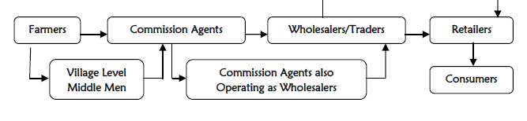
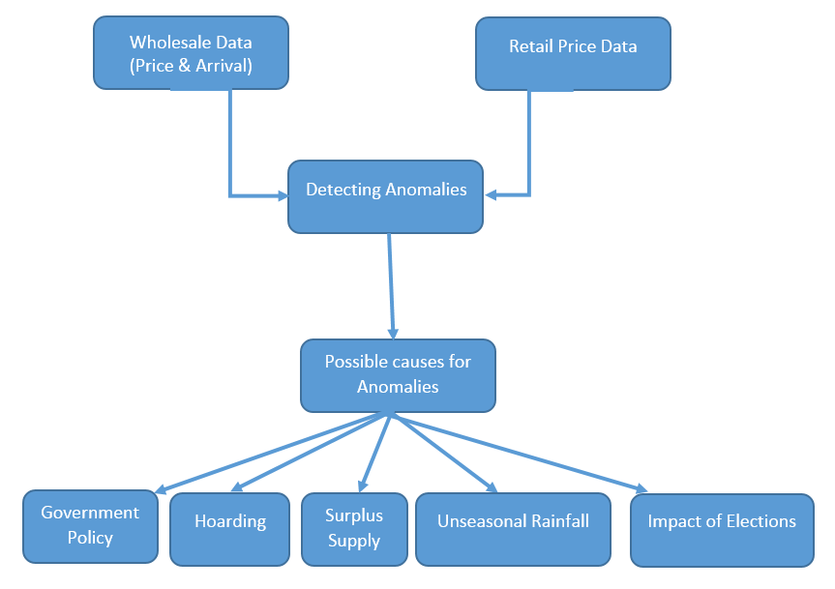
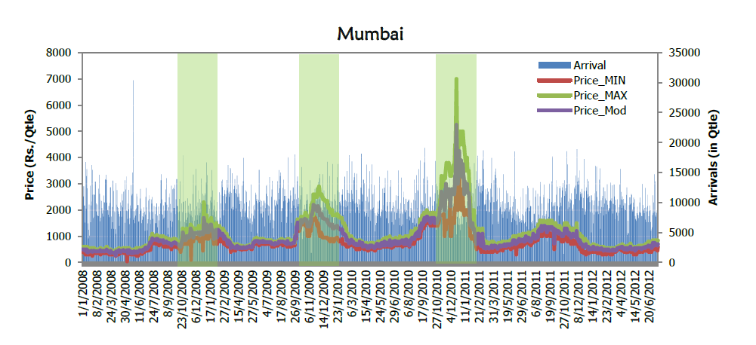
Data Analysis of Commodity Prices
Kapil Thakkar, Reshma Kumari,
Dr. Aaditeshwar Seth
MOTIVATION
Price of Agricultural commodities are more volatile than those of the non­farm commodities
High inflation of food commodities cannot always be attributed to risks, exogenous shocks and mismatch between demand and supply. It is also caused by market inefficiencies, weak supply chain and monopolies in the market.
MATERIALS AND METHODS
Visit the field, interview the various players of the market and understand the working of system.
Aggregate the data over past 15 years of the arrivals, Maximum and Minimum prices of various commodities at various Mandis across India, State and National Election Years
Aggregate the data of retail prices of various commodities across major cities of India.
Compare them over time and find the glitches
OBJECTIVE:
To understand the role of the various players in the supply ­chain.
To analyze time series data on production (based on arrivals at Mandis), wholesale price and retail price across various part of countries.
To detect anomalies/glut in the data
Detect a reason for anomaly (due to hoarding, unseasonal rain or something else)
One reason for anomaly may be the strong connection between politicians and agriculture related firms, due to which, during election year politicians use this to raise the party fund and we see glitches in the prices.
PROJECT OUTLINE:
COMPUTER SCIENCE & ENGINEERING IITD
EXAMPLE:
REFERENCES:
Chengappa, P. G., A. V. Manjunatha, Vikas Dimble, and Khalil Shah. "Competitive Assessment of Onion Markets in India." Institute for Social and Economic Change. Competition commission of India 1 (2012): 86.
Sukhtankar, Sandip. "Sweetening the deal? political connections and sugar mills in india." American Economic Journal: Applied Economics 4, no. 3 (2012): 43-63.

